Slide 1
Designing Autonomous Workflow via Bayesian Optimization
Arpan Biswas, Research Assistant Professor, University of Tennessee-Oak Ridge Innovation Institute
10th July 2024, Tennessee Advanced Material Summit Workshop Tutorial

Slide 2
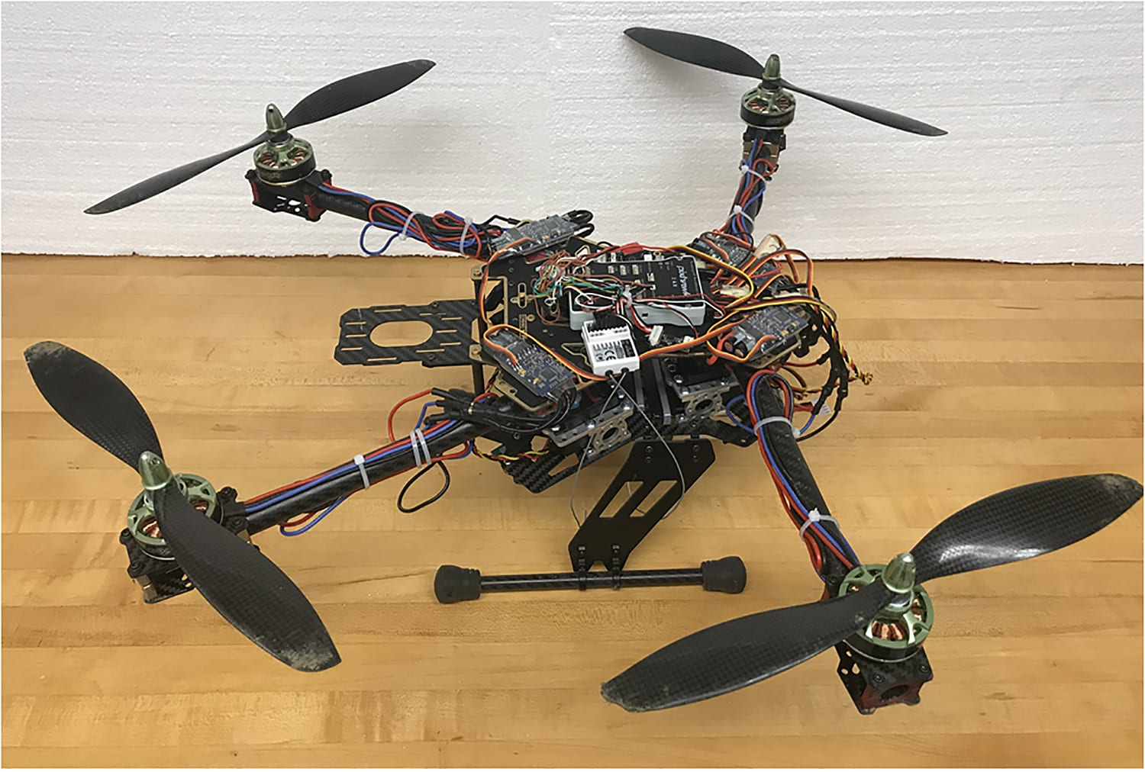
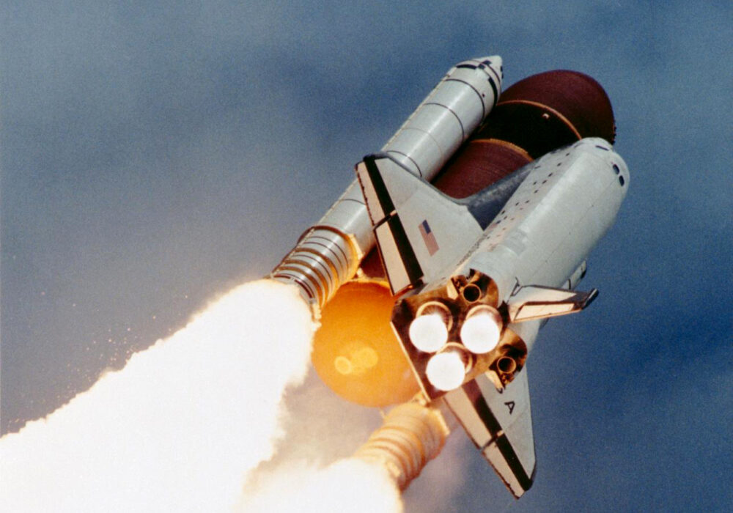
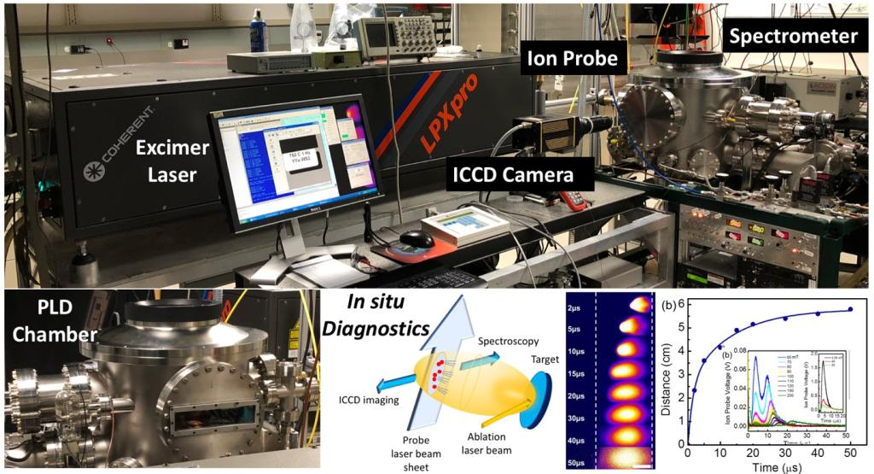
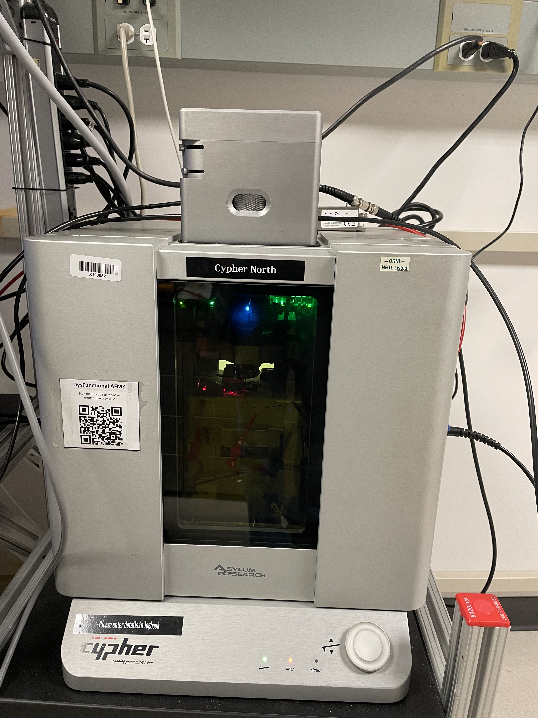
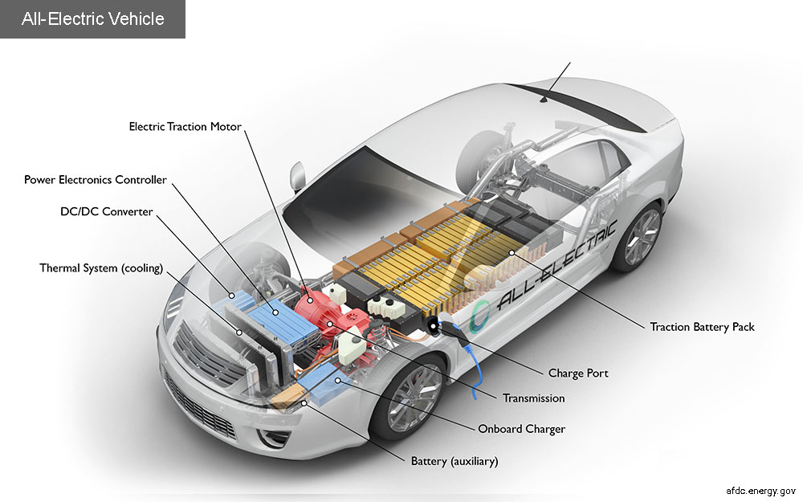
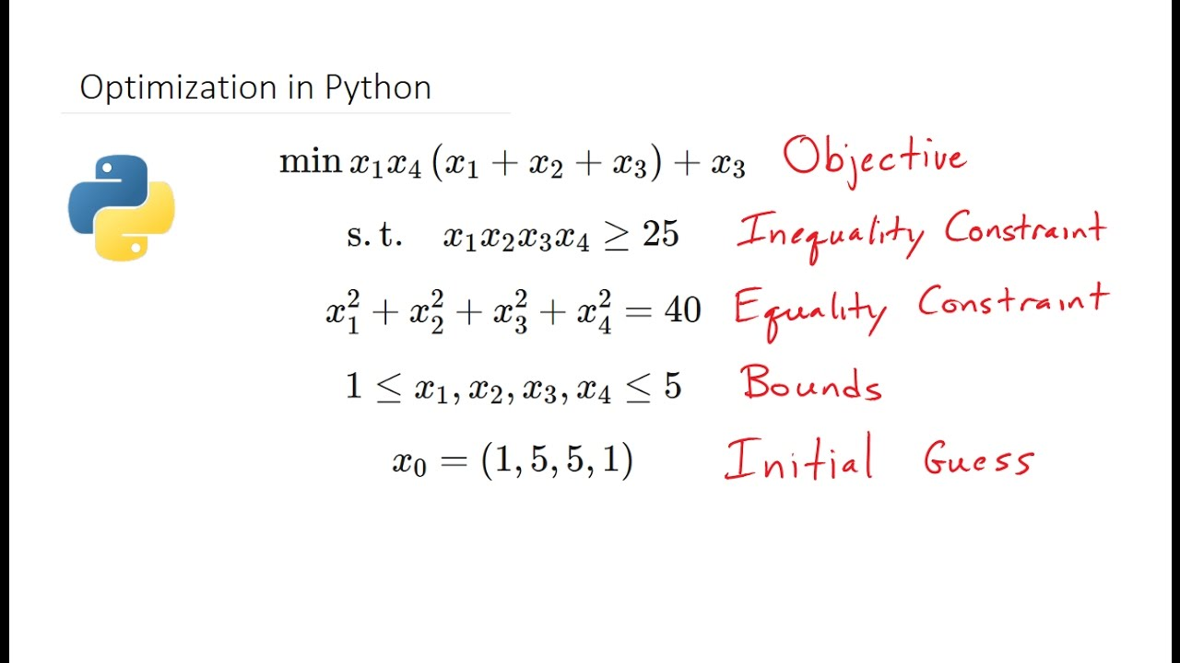
What is Optimization?
Pulsed Laser Deposition at CNMS, ORNL
A Simple Optimization framework
Scanning Probe Microscope at CNMS, ORNL
Technique to efficiently find the best choice of control parameters which returns the user desired outcomes
Set of Control variables
1
Notes:
Provide a workflow of a numerical optimization problem, Define what are control variables, function, constraints etc

Slide 3
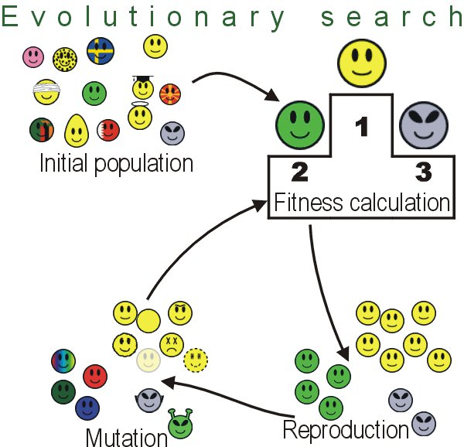
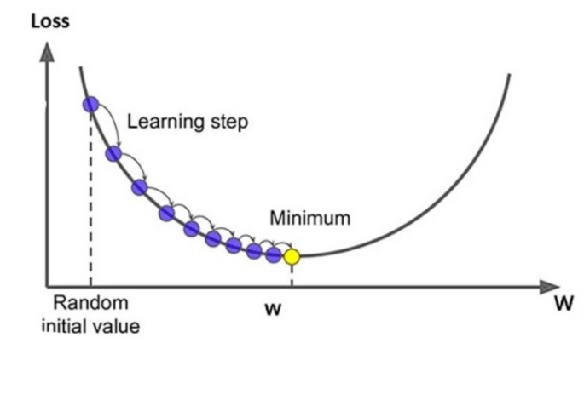
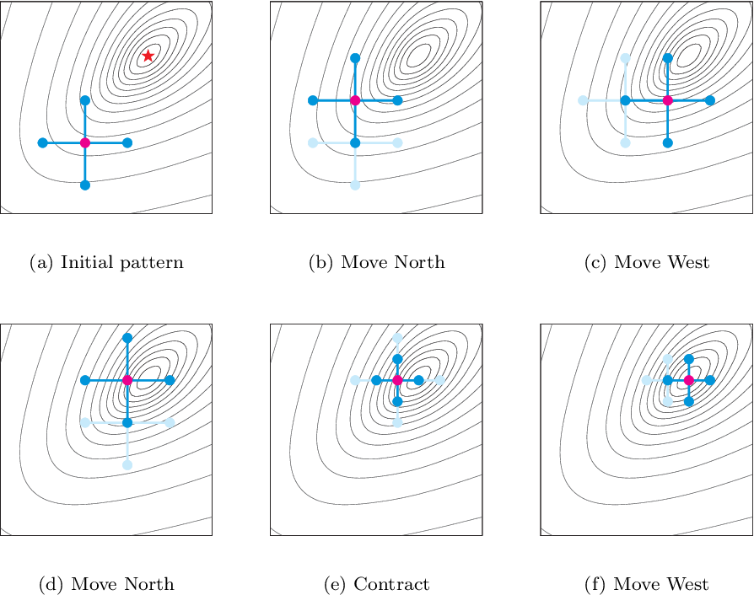
Numerical approaches to solve optimization problems
Direct Search
No gradient calculation.
Simple guidance to move towards optimality.
Converges locally.
Slow.
Gradient Based
Need to calculate gradient/hessian of the functions.
Converges locally.
Fast.
Heuristic Method
No gradient calculation.
Probabilistic approach to move towards optimality.
Converge globally
Very slow
Gradient based
Direct Search
1
Notes:
Draw a flow chart of different methods such as direct search, gradient based, evolutionary (GA) etc

Slide 4
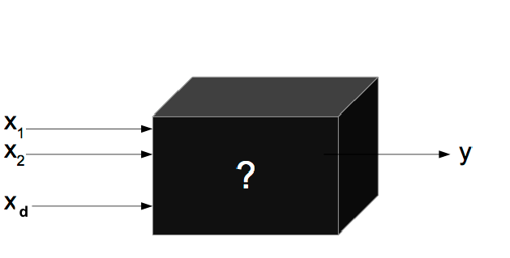

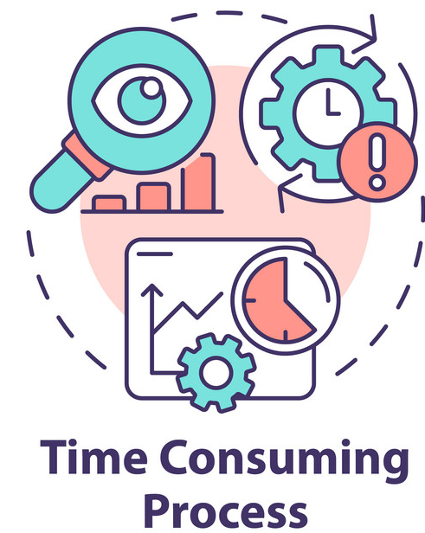
In real world, do we always have a simple and known function to optimize?
Real World Optimization Problem Setup
Black-box
Gray-box
Some Domain knowledge
White-box
Black-box
1
Notes:
Talk about the challenges of obj function- black box and or expensive. Provide few such examples such as Ising model/ quantum models, microscopy exp, PLD etc.

Slide 5

How can we solve an expensive black-box optimization problems?
Material characterization – Black/Gray box
E.g. Scanning Probe Microscopy (SPM), Atomic Force Microscopy (AFM), Electron Microscopy, X-ray diffraction spectroscopy etc.
Simulation models – Time consuming
Ising Model, Density Function Theory (DFT), Molecular Dynamics (MD), density matrix renormalization group (DMRG), Quantum Monte Carlo (QMC)
Material synthesis - Black/Gray box plus time consuming
E.g. Pulsed laser deposition (PLD)
Goal: A global black-box optimization method with maximum convergence speed.
1
Notes:
Talk about the challenges of numerical approaches such as gradient based- no underlying well defined function to cal gradient, converge to local; for random search, brute force, evolutionary – need a lot of iterations to converge
Goal to have a global optimization method with minimum evaluation or maximum convergence speed.
That’s active learning method: Eg- Bayesian optimization

Slide 6


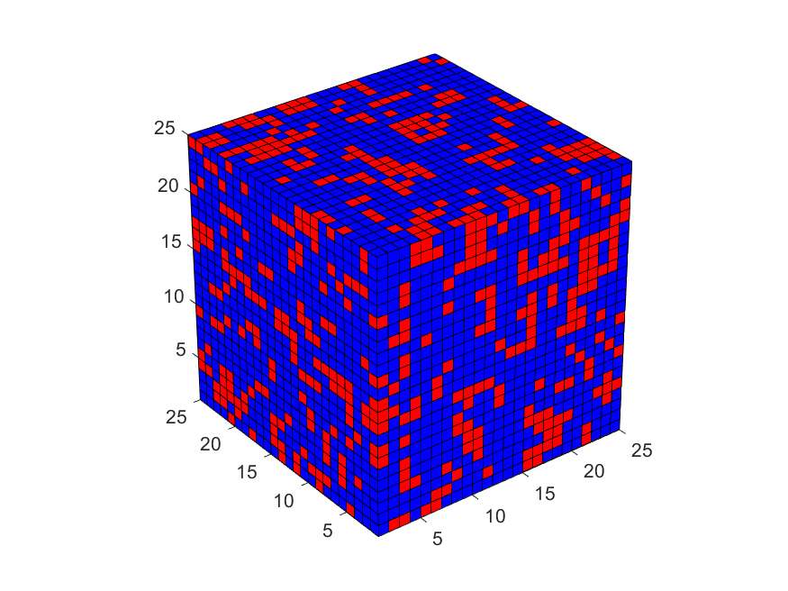
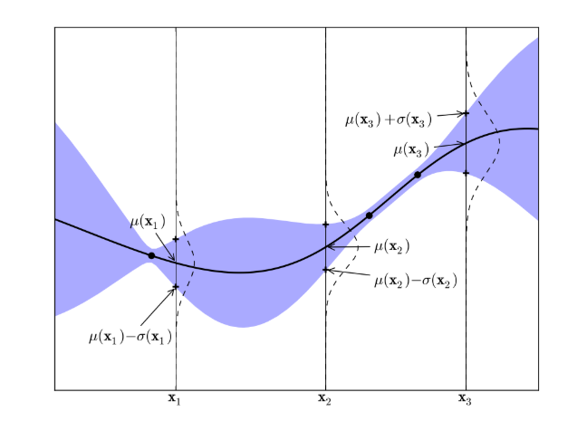
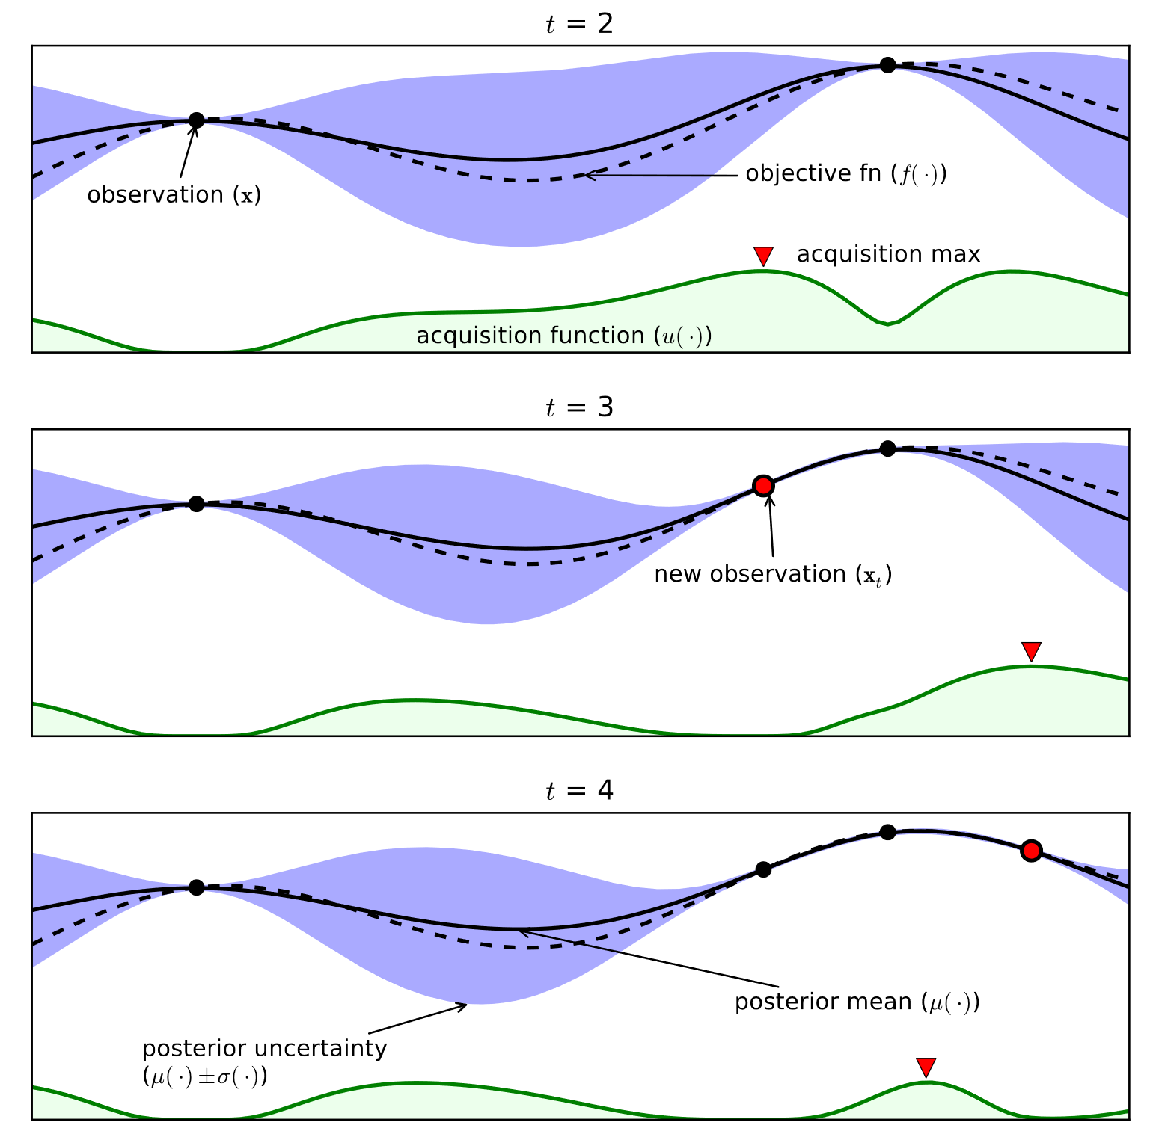
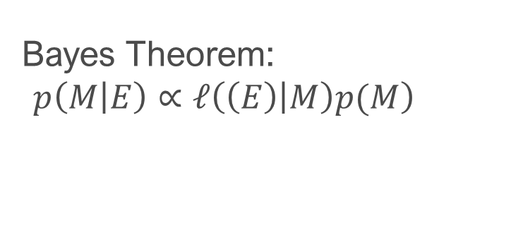
Active Learning: Bayesian Optimization
ML policy: Which simulation/experiment to conduct?
Prior probability
Bayes Theorem:
$$\left.p\left(M | E\right)∝𝓁\left(\left(E\right) | M\right)p(M\right)$$
Model
Evidence
Likelihood function
Objective
Posterior probability
simulation result
2

Slide 7
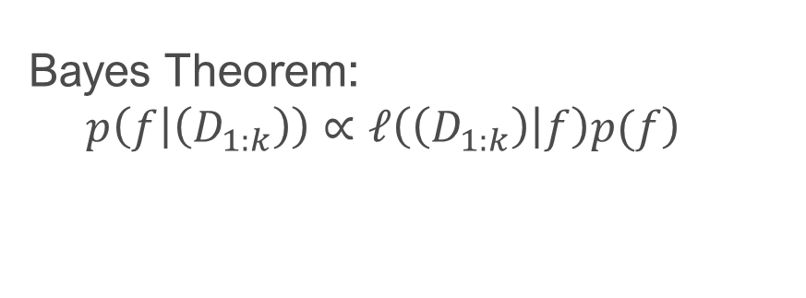
Active Learning: Bayesian Optimization
Likelihood function: How likely the data we have observed?
ML policy: Which simulation/experiment to conduct?
Training data
Prior belief
Bayes Theorem:
$$\left.p\left(f | \left(D_{1:k}\right)\right)∝𝓁\left(\left(D_{1:k}\right) | f\right)p(f\right)$$
Function to optimize
Expensive to evaluate
Black-box in experiments
Objective
simulation result
How to building posterior model?
Gaussian Process Regression
3

Slide 8
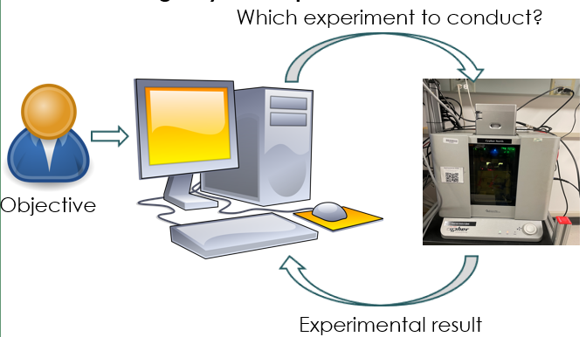
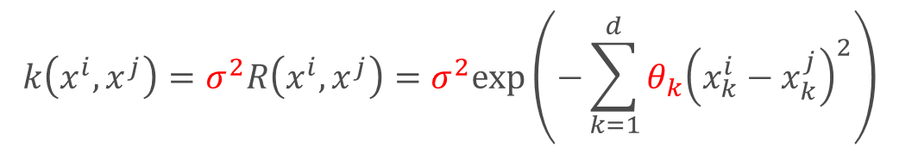
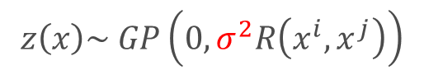
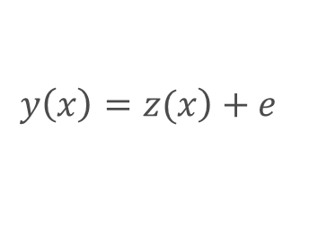
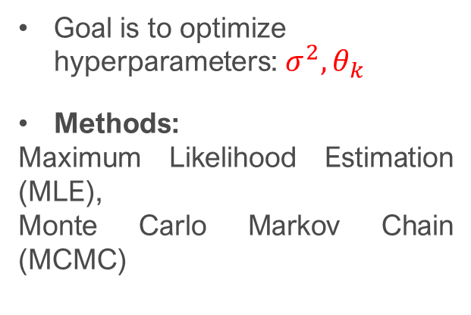
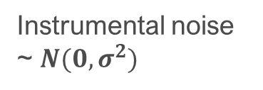
Bayesian Optimization: Prediction Model
Gaussian Process Regression
data
Predicts unexplored region
Provides measure of uncertainty.
Zero mean function
$$\left.y\left(x\right)=z(x\right)+e$$
Goal is to optimize hyperparameters: $σ^{2},θ_{k}$
Methods:
Maximum Likelihood Estimation (MLE),
Monte Carlo Markov Chain (MCMC)
$$z\left(x\right)\sim GP\left(0,σ^{2}R\left(x^{i},x^{j}\right)\right)$$
Instrumental noise ~ $N(0, σ^{2})$
Covariance function
$$k\left(x^{i},x^{j}\right)=σ^{2}R\left(x^{i},x^{j}\right)=σ^{2}exp\left(−\sum_{k=1}^{d}{θ_{k}{\left(x_{k}^{i}−x_{k}^{j}\right)}^{2}}\right)$$
4

Slide 9
Bayesian Optimization: Prediction Model
Gaussian Process Regression
data
Predicts unexplored region
Provides measure of uncertainty.
Marginal Probability Distribution
Kernel matrix
Standard deviation
$$p\left(y\right)\sim N\left(0,C\right)where C=K+σI (Adding noise)$$
$$c\left(x^{i},x^{j}\right)= k\left(x^{i},x^{j}\right)+σ_{ij}$$
5

Slide 10
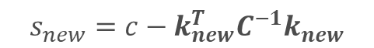
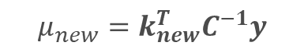
Bayesian Optimization: Prediction Model
Gaussian Process Regression
data
Predicts unexplored region
Provides measure of uncertainty.
Conditional distribution for new observation
$$p\left(y_{new}|y\right)\sim N\left(μ_{new},s_{new}\right)$$
$$μ_{new}=k_{new}^{T}C^{−1}y$$
$$s_{new}=c−k_{new}^{T}C^{−1}k_{new}$$
$k_{new}^{T}$= $[k\left(x^{1},x^{new}\right)$, $k\left(x^{2},x^{new}\right)$,…., $k\left(x^{n},x^{new}\right)$]
$$c=k\left(x^{new},x^{new}\right)+σ$$
6

Slide 11
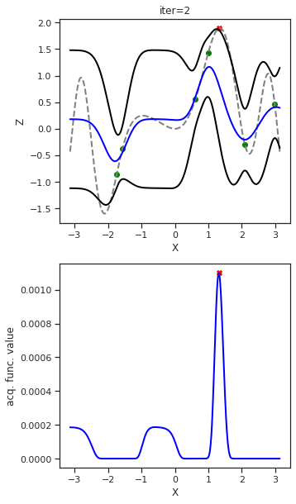
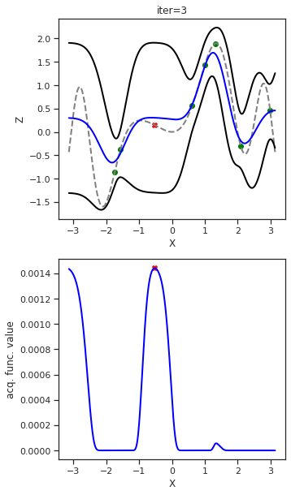
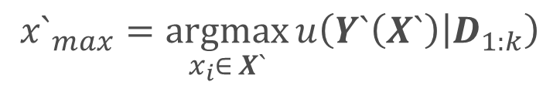
Bayesian Optimization: Acquisition Functions
$${x`}_{max}=\underset{x_{i}∈ X`}{argmax}{u\left(Y`\left(X`\right) | D_{1:k}\right)}$$
Unsampled data
Training data
Next candidate
Acquisition function
Trade-off between exploration and exploitation
Select future experiments
Guidance with alignment to human static objective
GP mean
GP variance
Exploitation
Exploration
7

Slide 12
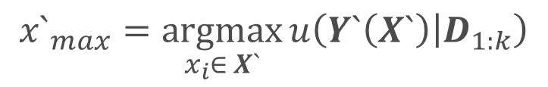
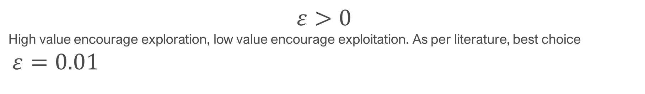
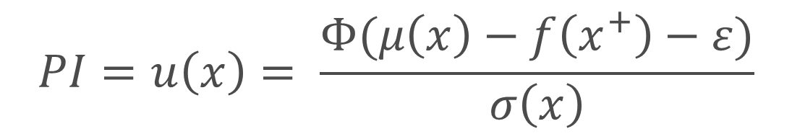
Acquisition Function: Probability of Improvement
$${x`}_{max}=\underset{x_{i}∈ X`}{argmax}{u\left(Y`\left(X`\right) | D_{1:k}\right)}$$
Unsampled data
Training data
Probability of Improvement (PI): $P(f\left(x\right)≥f\left(x^{+}\right)+ ε)$
Best solution (Current)
CDF
Trade-off factor
$$PI=u\left(x\right)= \frac{Φ(μ\left(x\right)−f\left(x^{+}\right)−ε)}{σ\left(x\right)}$$
$$ε>0$$
High value encourage exploration, low value encourage exploitation. As per literature, best choice
$ε=0.01$
8

Slide 13
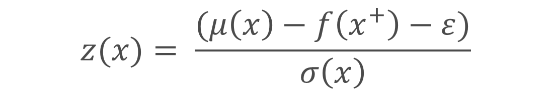
Acquisition Function: Expected Improvement
$${x`}_{max}=\underset{x_{i}∈ X`}{argmax}{u\left(Y`\left(X`\right) | D_{1:k}\right)}$$
Unsampled data
Training data
Expected Improvement(EI): $I\left(x\right)=max⁡\{0, (f\left(x\right)−f\left(x^{+}\right)−ε\}$
CDF
pdf
$EI= u(x)=$ $\left(μ\left(x\right)−f\left(x^{+}\right)−ε\right)Φ\left(z\right)+ σ(x)φ(z)$
$$z(x)= \frac{(μ\left(x\right)−f\left(x^{+}\right)−ε)}{σ\left(x\right)}$$
9

Slide 14
Acquisition Function: Confidence Interval
$${x`}_{max}=\underset{x_{i}∈ X`}{argmax}{u\left(Y`\left(X`\right) | D_{1:k}\right)}$$
Unsampled data
Training data
Upper Confidence Interval (UCB) : For Maximization
$UCB= u(x)=$ $\left(μ\left(x\right)+βσ(x)\right)$
Lower Confidence Interval (LCB) : For Minimization
Trade-off factor
$UCB= u(x)=$ $\left(μ\left(x\right)−βσ(x)\right)$
10

Slide 15
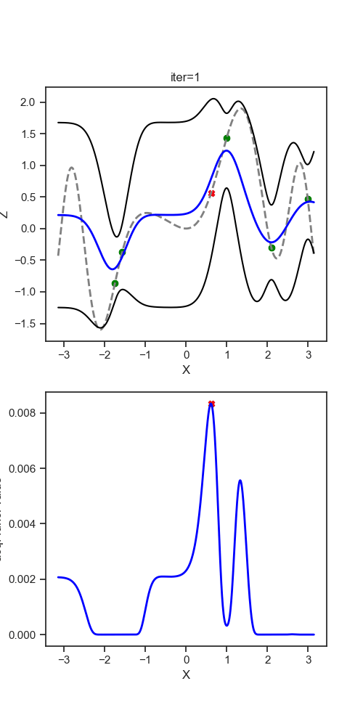
Active Learning: Bayesian Optimization
Region of Interest
Prediction Model
Objective
(Maximize)
Future sample selection
11

Slide 16
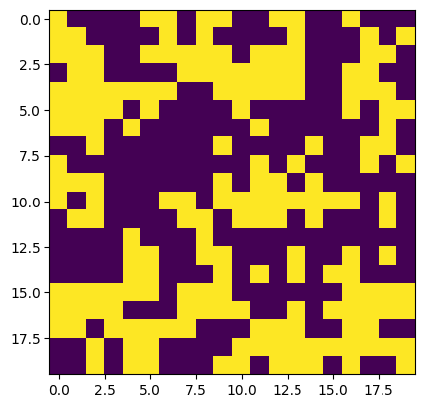
Today’s Exercise: To find critical values of parameters of Ising model
Gray-box Model
20x20 Lattice Size
Objective
To learn phase transition at the ferromagnetic region over exploring 20x20 lattice size
Optimization Problem Statement
Maximize Heat Capacity
Explore Parameter space: Spin-spin interaction strength
1

Slide 17
Time for some Hands-on:
Numerical Problems
Ising model Problem with 20 x 20 Lattice Size
12

Slide 18
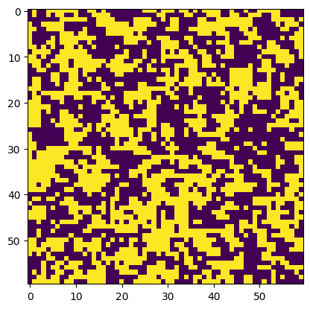
Concluding Statement: How much can we achieve from standard BO?
60x60 Ising model
Objective
Can we increase the convergence speed?
We want to explore 60 x60 or 120x120 lattice size model.
Motivation Question
Is still standard BO enough?
Time for each simulation is ~ 8 mins
15

Slide 19
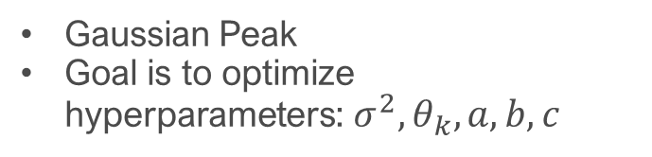
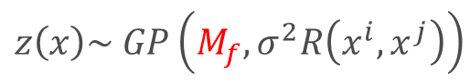
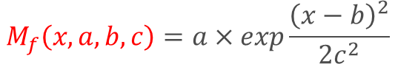
Active Learning: Structured Bayesian Optimization
Maxim A Ziatdinov et al 2022 Mach. Learn.: Sci. Technol. 3 015003
Gaussian Process Regression
data
Predicts unexplored region
Provides measure of uncertainty.
Physics knowledge injection
Mean function model
$$\left.y\left(x\right)=z(x\right)+e$$
$$z\left(x\right)\sim GP\left(M_{f},σ^{2}R\left(x^{i},x^{j}\right)\right)$$
Gaussian Peak
Goal is to optimize hyperparameters: $σ^{2},θ_{k}, a, b, c$
$$M_{f}\left(x, a,b,c\right)=a×exp\frac{{\left(x−b\right)}^{2}}{2c^{2}}$$
$p\left(a\right)=halfN\left(0.5\right)$, $p\left(b\right)=halfN\left(1.17\right),p\left(c\right)=halfN(2)$
13

Slide 20
Time for some Hands-on:
Let's try if we can get better convergence with sGP
14

